Slide 1

Outsourced Support Strategy | Execution | Innovation

Slide 2
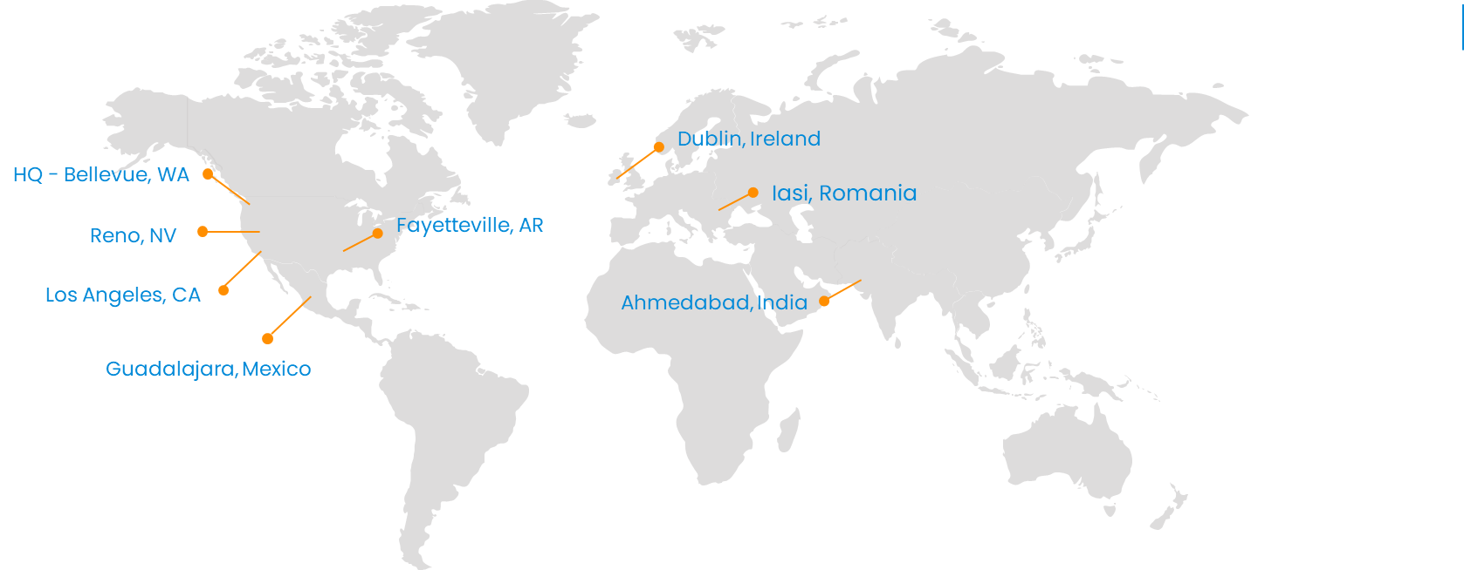








Company Background - Affirma Overview
OUR MISSION
“Become the best at applying solutions and services to positively impact people.”
850+
Employees Globally
98%
Customer Satisfaction
24
Years in business

Slide 3












Company Background - Our Clients

Slide 4
Company Background - Business Units & Services
BPO
Business Process Outsourcing
Customer Experience
Helpdesk Support
Partner Support
Technology
Content Management Systems
Web & Mobile Applications
Systems Integration
Line of Business Applications
Data & Analytics
AI & Machine Learning
Reporting & Analytics
Data Visualization
Data Warehousing
Infrastructure
Office 365
Azure & AWS
MMD, Exchange, Active Directory
System Center
Modern Workplace
Microsoft SharePoint & Teams
Document Management
Business Process Automation
Corporate Communications
Design
User Experience Design
Visual Design
Rapid Prototyping
Journey Mapping
Digital Marketing
Marketing Automation
Social Media, Paid Social
Content Strategy & Copywriting
SEO / SEM (PPC)
CRM
Salesforce
Dynamics 365
HubSpot
Marketo

Slide 5
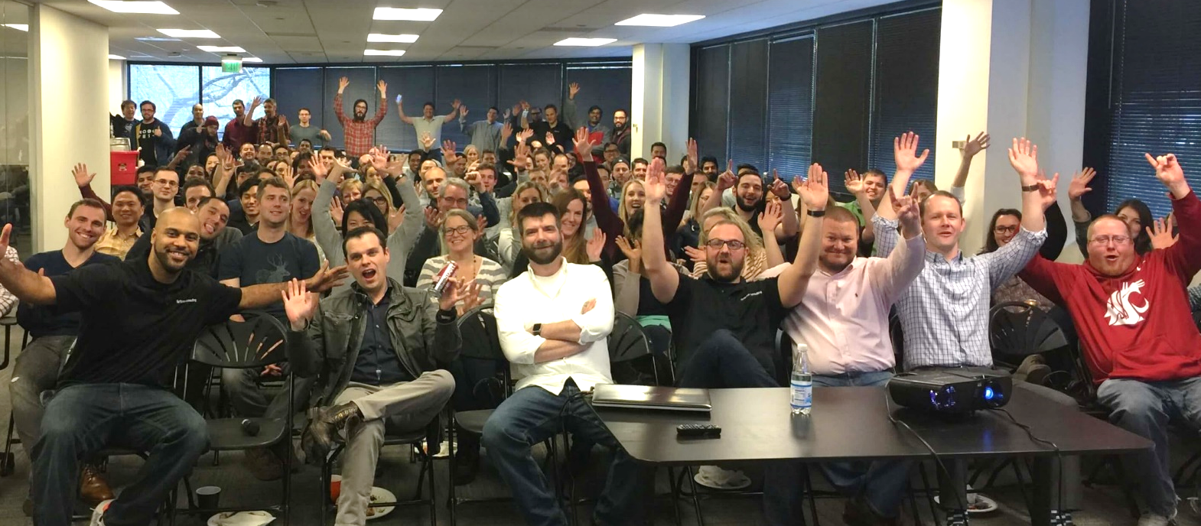



Company Background - Employee Satisfaction
Employee Satisfaction
Since Affirma was founded 22 years ago, Employee Satisfaction and Customer Satisfaction have been our top organizational values. Our CORE (Career Objective Review Evaluation) Program helps establish short-term and long-term goals for every team member. Affirma’s leadership team is very diligent in facilitating employee feedback loops through multiple channels to ensure employees are heard and the company is frequently and proactively addressing areas for improvement.
Our Culture
We have an incredibly positive, collaborative, supportive, and diverse culture at Affirma. Here is a quick video to provide some insight from our team members into what it’s like to work for Affirma, and the amazing partnerships we have with our clients.

Slide 6




Security & Compliance
DEDICATED COMPLIANCE & SECURITY TEAM
GLOBAL COVERAGE & SCALABILITY
REQUIRED EMPLOYEE DATA PRIVACY TRAINING
Security & Compliance
We are ISO 27001 certified as an organization globally which provides a strong foundation in many data privacy regulatory requirements.
In addition, we have a dedicated Compliance Officer and team focused on managing industry-specific and client-specific regulatory requirements. Our team builds processes, policies, and recurring training to ensure perfect adherence to these requirements. Core data privacy regulations like GDPR, CCPA, and HIPAA serve as our guides for data privacy in their respective applications.
We follow the principle of least privilege when determining the level of access needed for our team members. And all employees globally are required to take annual cybersecurity and data privacy training and exams.

Slide 7









Customer & Partner Support
Global 24/7 & Multi-Language Support
Affirma operates utilizing US-based, near-shore, and global resourcing depending on our client's preference and needs. Our global coverage allows our teams to provide support 24/7 across multiple languages as needed.
Flexible Service Level Agreements
We offer flexible SLAs and response time adherence measures that can scale up or down depending on requirements for time zone coverage, pricing, channels, team size, and skill sets.
Measurable Analytics & Insights
We hold ourselves accountable by providing our clients with data insights such as ticket volume, response times, CSAT scores, and more. Our clients have close visibility to the work being done, what we're learning from it, and our recommendations for their business.
High-Quality, Scalability
We take the headache out of hiring and managing full-time employees off your plate while saving you time and money. Our Customer Support outsourcing solutions focus on delivering quality customer experiences with the ability to scale on demand.
Enterprise-level customer support outsourcing backed by 20+ years of experience.
Multi-Channel Customer Support
US-Based, Nearshore, & Global Support
Full 24/7 Support
SLA Adherence & Language Support
Remote Capabilities
Comprehensive Quality Assurance
Enterprise-Level Scalability
CX Analytics & Insights

Slide 8
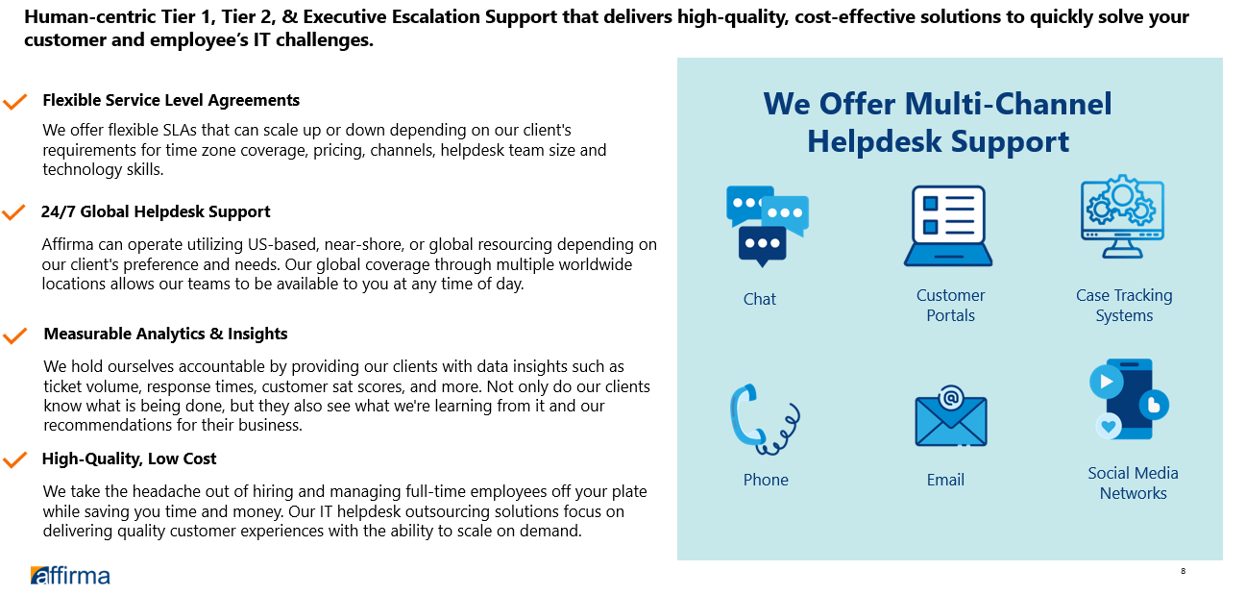
IT Helpdesk Support – Tier 1, 2 & 3

Slide 9
Team Structure
Vice President - BPO
Director - BPO
Account Manager
Internal Team Structure
VP and Director Roles are non-billable, established to provide internal team support and performance management.
Director can be main Point of Contact for stakeholders and escalations if desired; otherwise, Team Lead will serve this function and Director will act as an escalation with check-ins for delivery.
VP Role will be an escalation point if needed and involved for first 6 months.
Support Team
(Non-Billable)
Support Agent Team Lead (Optional)
Support Agent
Support Agent
Support Agent
Support Agent

Slide 10


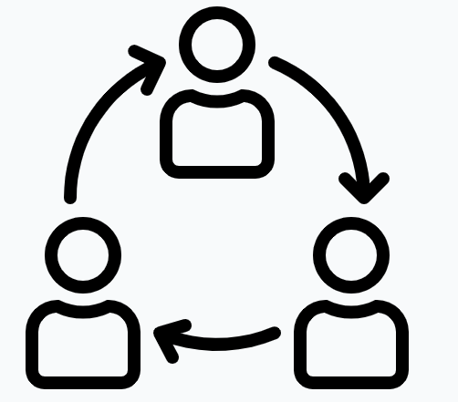
Recruitment & Training
Customer focus
Our approach focuses on a baseline of relevant experience, soft skills, and culture fit. These roles should be a step forward for someone in their career, to ensure the passion for Customer Support exists.
Recruiting Pipeline
Affirma has partnerships top local universities near all our global hubs which funnel a consistent pipeline of candidates for Affirma’s bench and open roles across teams. We also prioritize opportunities to promote from within when possible.
Additionally, our global recruiting teams source candidates and perform comprehensive initial screenings. Qualified candidates interview with a Team Lead, followed by our Director and VP of BPO before being selected for a client program.
We follow a 3 phased approach to training:
Shadowing: onboarding, documentation and process reviews, shadowing existing team.
Reverse Shadow: Take on support activities with occasional help needed from senior team members.
Steady state: Full ownership of support with continuous improvement and regular training sessions.
In Depth Screening
Training

Slide 11
Implementation Plan & Timeline
Resources will be onboarded and start within 2-6 weeks from contract signature. Training windows will begin after they start.
During this time, Affirma follows a phased approach to build the operation without delay.
Mobilization
Stabilization
Steady State
Onboarding, Discovery, Knowledge Transfer & Shadow current team
Work jointly to transition Support activities and program management
Take over all support activities and program management
Mobilization
Discovery: Affirma team begins discovery and onboarding with client program managers.
Documentation: Review and understand available documentation:
Standards, policies, and SOP’s
Support & escalation mechanisms
Brand guidelines & communication standards
Onboarding: Support team member hiring and onboarding
Training: Comprehensive training for new team members. Recurring training for agent advancement and new hire waves.
Stabilization
During stabilization, Affirma will handle the full scope of customer support functions but may require occasional support from existing teams or our client’s SME’s when needed.
During Stabilization, Affirma will perform the following services:
Comprehensive customer support across all channels.
Monitor resolution of support requests and measure performance.
Review support processes and operations and make necessary improvements.
Review reporting processes and make necessary improvements.
Steady State
During Steady State, Affirma will assume full ownership of all support as described for stabilization, but should require minimal or no support from Client SME’s.
During Steady State operations, Affirma works with our clients to ensure quality through:
Ongoing training and agent development.
Regular business review cycles to analyze performance and quality data to drive optimizations to our process and approach.
Engaging our dedicated Compliance team to manage adherence to client-specific and industry-specific regulatory standards.

Slide 12
Implementation Plan & Timeline
MOBILIZATION
STABLIZATION
STEADY STATE
INNOVATION
Onboarding
Program Planning
Discovery
Knowledge Transfer
Documentation
Customer Support
Fully Autonomous
Support Team
Program Reporting, Advisory, & Ongoing Optimization
Process Improvement
Tech Implementation to Improve Intake, Automation & Analytics
Process Optimization
Applying Analytics, AI/ML
Support Volume Reduction, Self-Service
Occasional SME Engagement
Program Support & Governance

Slide 13
Quality Assurance - Program Governance
Affirma works with our clients to establish governance and a recurring business review cadence around our Customer Support programs.
Sample Business Review Meeting Cadence
Meeting | Weekly Alignment (Optional) | Monthly Business Review (MBR) | Quarterly Business Review (QBR) | Strategic Business Review (SBR)
Timing | Weekly | Monthly | Quarterly | Twice a year
Duration | 30 mins | 1 Hour | 1-2 Hours | 4 Hours
Meeting Owner | Supplier Ops Manager | Supplier Ops Manager | Supplier Ops Manager | Supplier Ops Manager
Client Attendees | TBD | TBD | TBD | TBD
Supplier Attendees | Supplier Ops Manager | Supplier Ops Manager Affirma Director Affirma VP of BPO | Supplier Ops Manager Affirma Director Affirma VP of BPO | Supplier Ops Manager Affirma Director Affirma VP of BPO
Objective | Weekly status update Open Case Status Help Needed | Monthly operational SLA & KPI performance reviews Review any open corrective action plans | Quarterly review of SLA & KPI along with long term trending to provide an overview of performance overtime Review of all Initiatives and Transformation projects | Executive overview of Supplier performance Sharing of both the Client and the Supplier strategic direction Unfiltered discussion around engagements between parties
Meeting Materials Due (PPT/xls & scorecard, as appropriate) |  | 48 hours prior to meeting | 48 hours prior to meeting | 48 hours prior to meeting

Slide 14
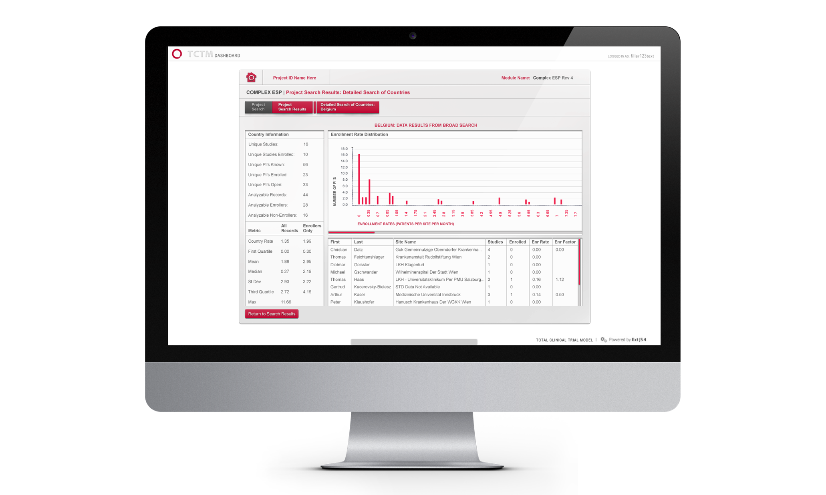
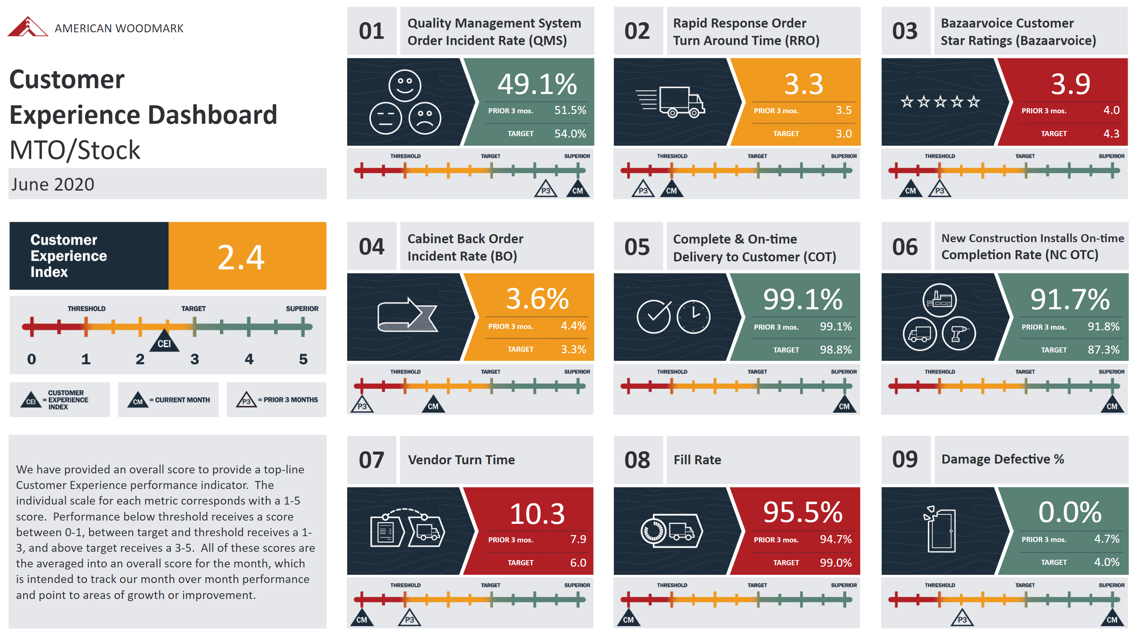
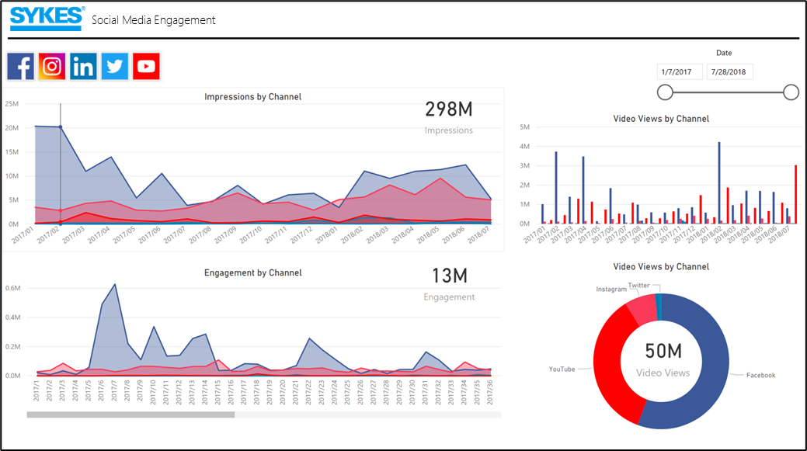
Quality Assurance - Tailored Reporting Solutions
In addition to standard reporting, Affirma’s dedicated Data & Analytics Practice works with our clients to build tailored reporting solutions to meet key requirements and gain insights across platforms. These are samples of custom reporting solutions built for our clients.

Slide 15
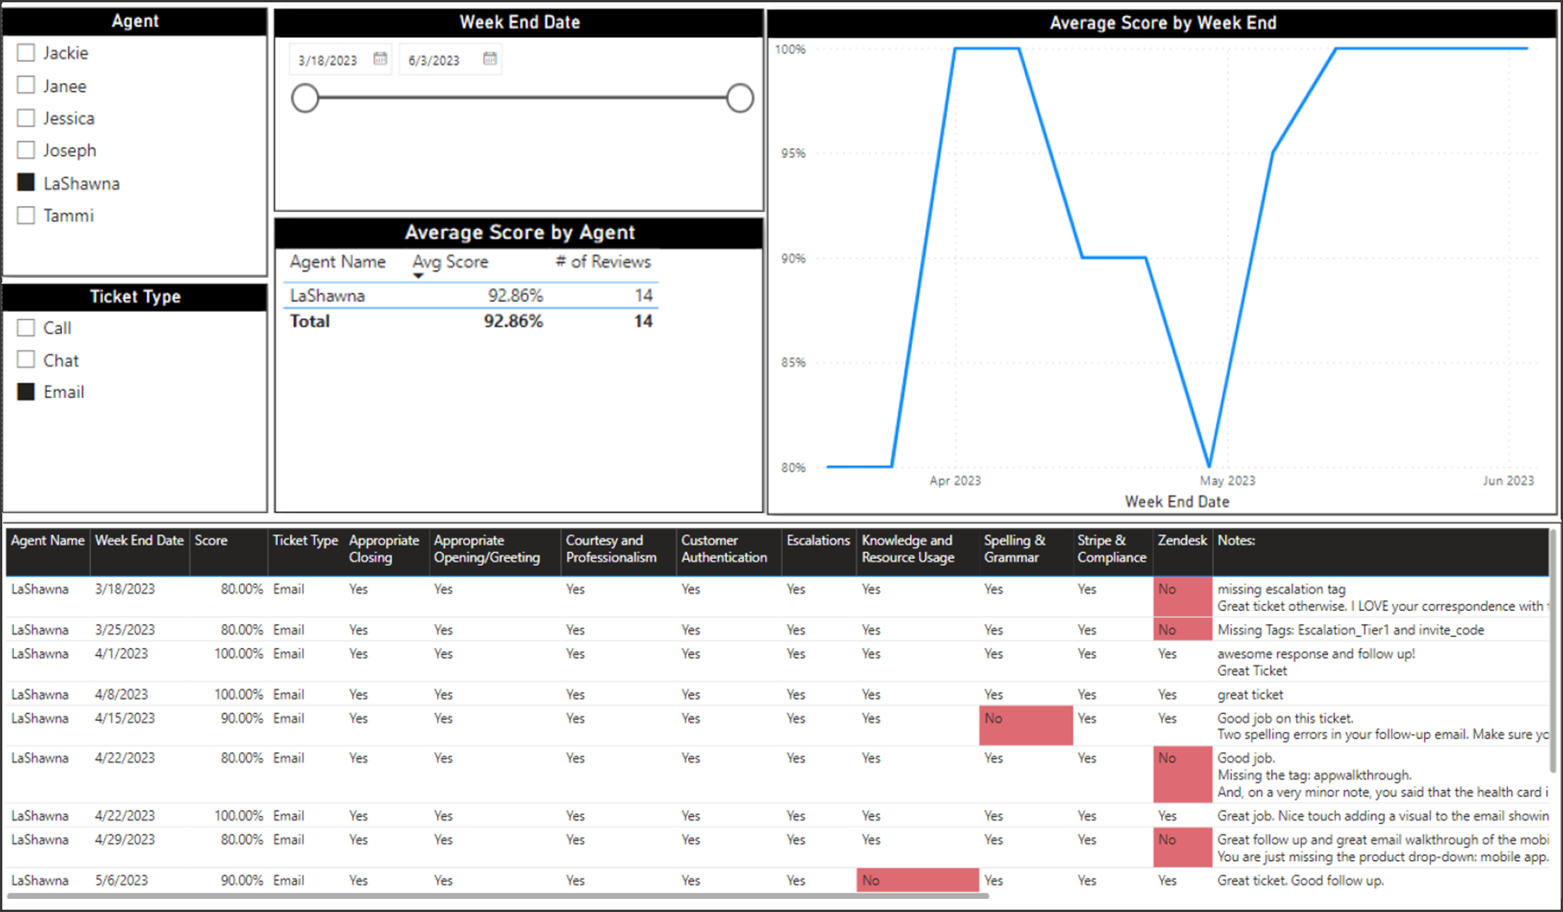
Quality Assurance - Sample Quality Scoring
Example reporting (sample data) we’ve established with other clients to provide live visibility on Quality Scoring for each agent within an operation.

Slide 16
Case Studies & Relevant Work

Slide 17

Aloe Care Health - Customer Support
Who They Are
Aloe Care Health is a healthcare technology company that offers remote patient monitoring and communication solutions for seniors and caregivers. Their main product is the Aloe Care Health Hub, a smart home device that includes features such as fall detection, emergency response, medication reminders, and vital sign monitoring capabilities. The device helps seniors maintain their independence while giving caregivers peace of mind by allowing them to monitor their loved ones' health and safety remotely.
Business Need Aloe Care Health was in search of a new onshore provider to replace their existing outsourced customer support department. The new provider needed to be able to handle 2,500 monthly chats, phone calls, and emails, as well as 1,000-1,200 monthly outbound calls. Additionally, the new team needed to be able to work within Aloe Care Health's existing Zendesk Suite framework. The goal was to improve the quality of customer support by having a fully onshore team that can handle a high volume of inquiries and provide excellent service.
Partnership Scope
Affirma is providing Aloe Care Health with 6 onshore resources to handle their customer service needs as described. These resources are available during the specified hours of operation, including weekdays from 9am to 9pm Eastern Standard Time and weekends from 10am to 7pm Eastern Standard Time. The current volume of inquiries are fully covered by Affirma’s resources. Affirms worked with Aloe Care Health to provide the necessary skills and training to be able to manage the workload outlined in the original business need.

Slide 18
Salarly - Customer Support
Who They Are
Salarly provides financial assistance to those in need, empowering their financial future with payroll-linked loans. They offer fast, online approvals and transparent terms with flexible repayment processes all within a secure platform.
Business Need Salarly is a newer, yet rapidly growing company and quickly developed the need to support an expanding customer base. We engaged with them and built a brand-new customer support operation, servicing their customers via phone, email, chat and social media. This operation will expand to EMEA in H2 of 2025.
Partnership Scope
Affirma built a team of Customer Support Reps in the US, which will expand to Ireland & Romania in H2 of 2025. The US Team will act as a Tier 2 mechanism, to support the Tier 1 function based in Europe.

Slide 19
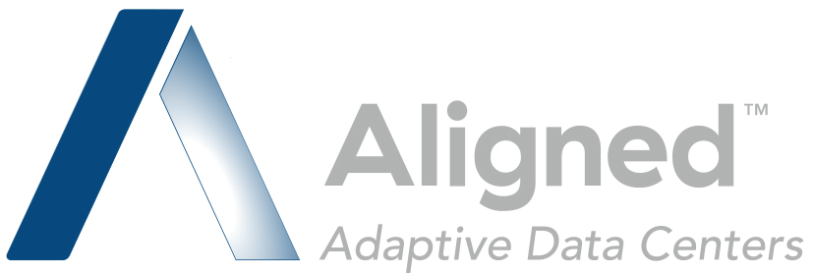
Aligned Data Centers - Customer Support
Who They Are
Aligned Data Centers is a data center infrastructure technology company. They specialize in providing sustainable and efficient data center solutions, including innovative cooling techniques and energy-efficient designs.
Business Need Aligned Data Centers had a critical need for comprehensive customer support services with seamless operations and high levels of customer satisfaction. Aligned’s requirements included:
Establishing a dedicated team of Customer Support Representatives (CSRs) to effectively manage customer interactions.
Implementing a scalable support structure that can adjust personnel levels based on fluctuating demand while maintaining operational efficiency.
Accessing key analytics and insights to drive data-driven customer care strategies and enhance overall customer experience.
Ensuring compliance and security measures, including background checks on CSRs and adherence to standardized processes.
Expanding support services to manage additional regions and meet the company's requirements for broader geographic coverage.
Partnership Scope
Affirma is responsible for providing tailored support services to address Aligned Data Centers' business needs including:
Building and managing a dedicated team of CSRs across three phases, gradually expanding resources to meet Aligned's requirements.
Ensuring efficient support function management to maintain smooth operations and meet service level agreements (SLAs).
Providing access to key analytics and insights for data-driven decision-making around customer care strategies and optimizing process.
Affirma is delivering efficient, scalable, and data-driven customer support operations, ultimately enhancing the overall customer experience for Aligned Data Centers.

Slide 20

Aftra Retirement Fund - Customer Support
Who They Are
The AFTRA Retirement Fund has provided retirement benefits to performers – including actors, broadcasters and voice professionals – for more than 60 years. The AFTRA Retirement Fund was established as a result of collective bargaining between the American Federation of Television and Radio Artists (AFTRA) and contributing employers.
Business Need AFTRA, due to demand from their customers and participants over the years, developed a Portal to manage funds, plans and other account information for their customers to self-serve information. To prepare for the launch, and ongoing usage of the portal, they needed to outsource the anticipated support that would arise from this new platform via phone, email and chat for over 300,000 participants.
Partnership Scope
Affirma built a team of Customer Support Reps and helped Aftra develop the Customer Support operation from the ground up. This included developing support playbooks, platform (Zendesk) stabilization and reporting mechanisms leading up to a "Go Live" date where the Affirma team would begin fielding calls, emails and chats to support Aftra participants.

Slide 21

Structured - IT Helpdesk Support
Who They Are
Structured is an IT, Security, and Cloud Consulting firm with a wide and growing range of services from security integration to data center operations, multi-cloud architecture to infrastructure management, networking and digital transformation. They were founded in 1992 and operate across 11 US locations.
Business Need Structured approached Affirma to help centralize their internal and external IT Helpdesk operations. Their goal was to expand to a 24-hour model and alleviate internal pressure from FTEs needing to cover Tier 1 – Tier 2 support requests, pulling them away from more strategic and revenue-generating priorities.
What We Did Affirma assembled a flexible team of Support Reps to support both internal and external helpdesk support. This covered end user support, Tier 1 and 2 customer help desk support, as well as process improvement with analytics and insights to drive optimization of Structured’s helpdesk program as a whole.

Slide 22

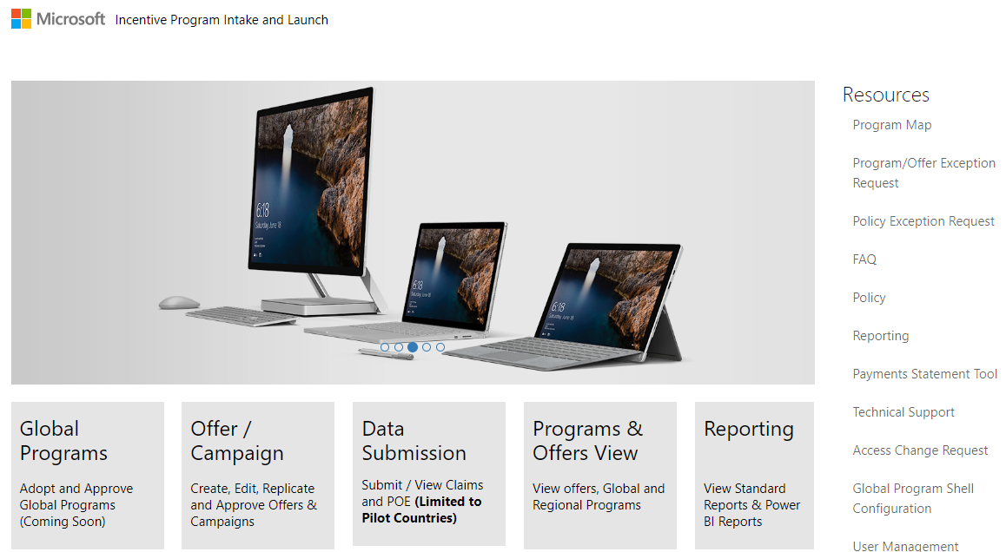
Microsoft Operations - Managed Team
Business Need
Microsoft’s Operations group had a global need for business process support and technical leadership across various teams. The need spanned from solution architecture design and application development, to business process administration and reporting. Affirma onboarded a comprehensive team to fill these gaps and add substantial business value for Microsoft.
Microsoft Operations
Team Size: 145
Locations: Seattle, India, Reno, Dublin
Duration: 2015 to Present
Ongoing Partnership
Affirma has established a long-term relationship with the Operations group and our team continues to grow as we support new initiatives. Ongoing services include:
Application design and development
Solution architecture redesign
Business Intelligence & Analytics
Ongoing enhancements & break-fix support
3rd party vendor collaboration and management
Business process support & change management

Slide 23
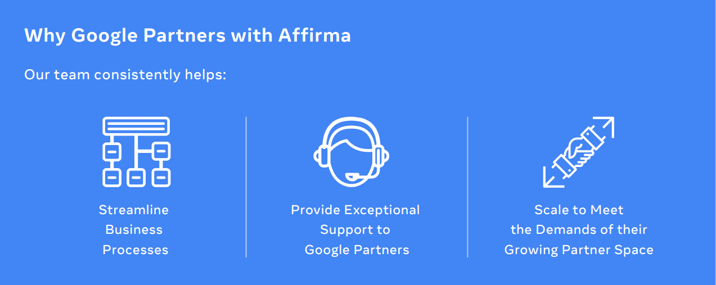
Google Cloud - Partner Incentives Managed Team
Business Need
Google was utilizing contractor services through multiple staffing companies. They were looking to consolidate their Suppliers to find one who could support their partner incentive space end-to-end and solve multiple problems including high turnover, difficulty managing multiple contractors, and difficulty keeping up with expanded partner incentive space.
Partnership Scope Our team was established to provide Partner Incentive Support, Management, and Execution.
Project/Program Management
Manage ongoing manual activities on a monthly/quarterly basis
Partnering with Google stakeholders to automate functions over time
Developed and improved business processes, organized complex data, and provided accurate sales tracking
Provide quality support to Google Partners
Leverage SQL, Salesforce, and Google Sheets to build out reporting pipeline and calculate incentive payments
Located all discrepancies in data and reporting tools that may cause risks such as in accurate sales tracking and payment calculations
Maintained accurate reports of partner incentive performance (targets, sales performance, and monitoring of payments earned)
Impact
On day 1 of the engagement, we built a team of 6 vendor resources and quickly expanded to 12 vendor resources in the first 6 months in multiple countries to support Google’s partnerships globally.
Within the first 3 months of our Google partnership, Affirma’s support team resolved a backlog of 800 inherited support tickets and were responsible for a 300% increase in payments as part of a particular incentive program.

Slide 24
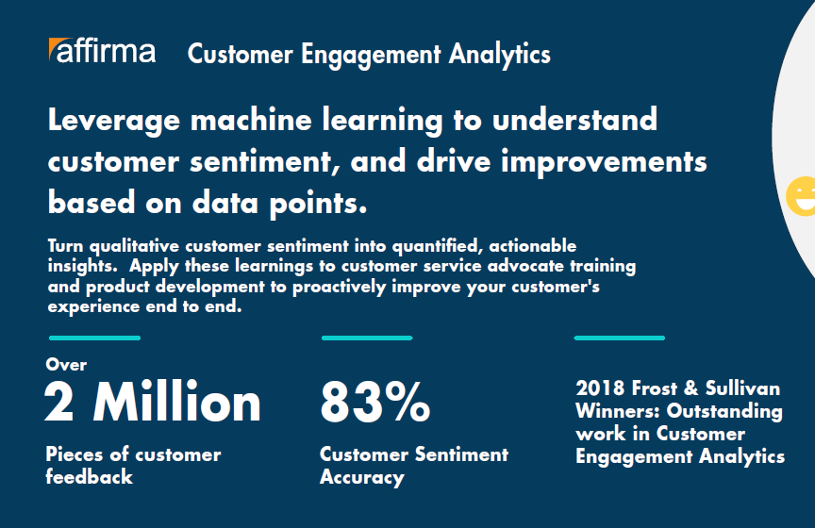
Innovation & Improvement - Examples
Affirma partners with our clients to ensure we’re consistently learning from our support programs, our clients, and their customers, to drive innovation and process improvement. These are examples of technological solutions we’ve implemented with our clients to improve their customer experience.
Voice of the Customer
Microsoft came to Affirma looking for support in their Voice of the Customer initiative. The goal was to capture qualitative customer sentiment and turn it into quantifiable, actionable insights.
The team developed a solution leveraging Azure Machine Learning, Power BI, and custom development.
The solution aggregates customer sentiment across chat data, survey verbatims, social media, and other data sources.
These insights are proactively applied across the business including; customer advocate training, product development, survey experiences and more.

Slide 25
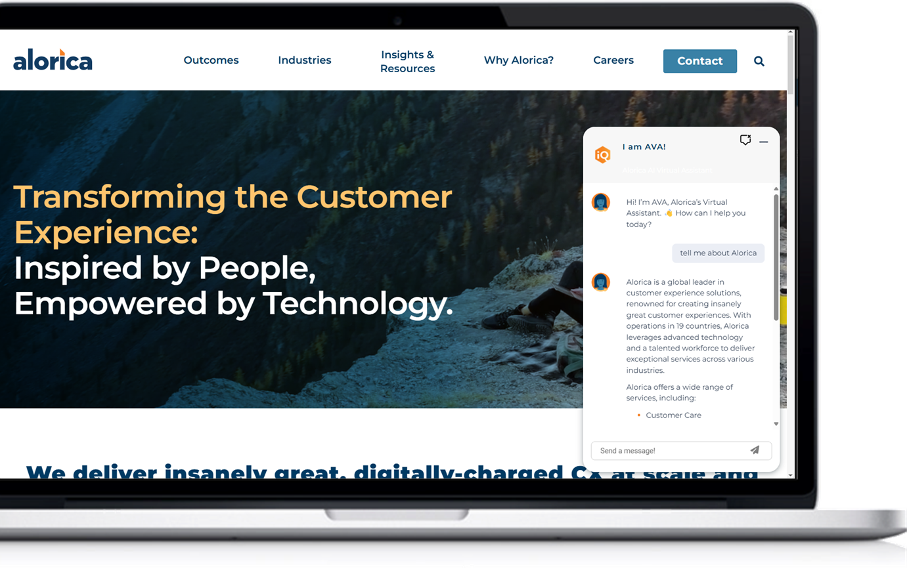

Innovation & Improvement - Examples
Affirma partners with our clients to ensure we’re consistently learning from our support programs, our clients, and their customers, to drive innovation and process improvement. These are examples of technological solutions we’ve implemented with our clients to improve their customer experience.
Website AI Chat Bot
Alorica came to Affirma for support in developing an AI-powered chat bot experience for their customers who interact with their website, to answer questions and guide visitors to the right information.
Affirma developed Python tools to ingest and understand the client’s data set, including website contents and company documents. These tools converted the data into chunk storage where inputs could be fuzzy-searched.
The front-end chat bot widgets were developed to be embedded on any HTML page, supporting both text and audio input/output using state of the art AI text-to-speech.

Slide 26

Meta - Outsourced Recruiting Team
Ongoing Partnership
Partner with Meta Reality Labs (RL) UX researchers to define scope, timeline, and recruiting specifications.
Manage end-to-end participant recruiting process for multiple RL UX Research projects, including sourcing, screening, distributing, and collecting NDAs, scheduling, processing compensation.
Work as Subject Matter Experts to define eligibility requirements to create screener questions to pull a targeted pool of candidates for UX researchers.
Work with a broad range of participant pools including but not limited to; end users, Developers, Creators, Workplace End Users, Managed and Unmanaged Customers.
Recruit from a wide variety of end users from Facebook, Instagram, and Oculus populations.
Coordinate logistics for the quality participant experience and ensure all necessary legal, compliance, and financial obligations are met.
Serve as a primary point of contact for participants regarding research participation logistics.

Slide 27
Thank You

